Slide 1
Capstone Project
Nji Dimitri Kedze
Data Analytics (Software)

Slide 2
Introduction
I was assigned to perform a sales analysis for EmporiUm, a student bookstore chain that also sells tech products, art supplies, and other products in the state of_ New Jersey in the Northeast Region
My Assigned manager is Miami Vue for the New Jersey State (Northeast Region)

Slide 3
Sales Analysis
What is total revenue overall for sales in the assigned territory, plus the start date and end date that tell you what period the data covers?
What is total revenue overall for sales in the assigned territory, plus the start date and end date that tell you what period the data covers?
Provide a comparison of total revenue for the specific sales territory and the region it belongs to.
What is the number of transactions per month and average transaction size by product category for the sales territory?
Can you provide a ranking of in-store sales performance by each store in the sales territory, or a ranking of online sales performance by state within an online sales territory?
What is your recommendation for where to focus sales attention in the next quarter?

Slide 4
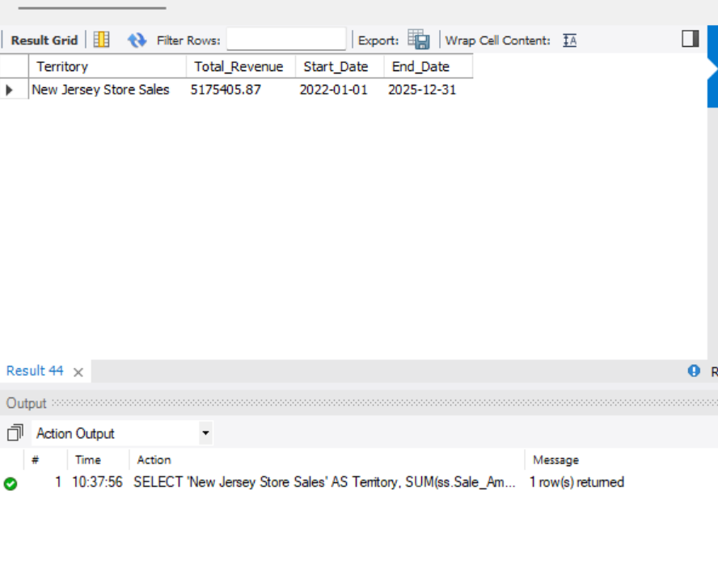
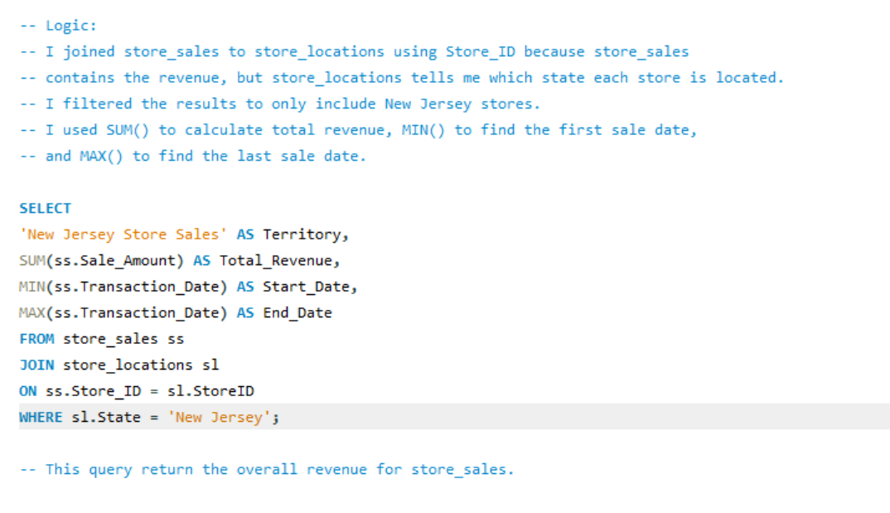
What is total revenue overall for sales in the assigned territory, plus the start date and end date that tell you what period the data covers?
Result
Query

Slide 5
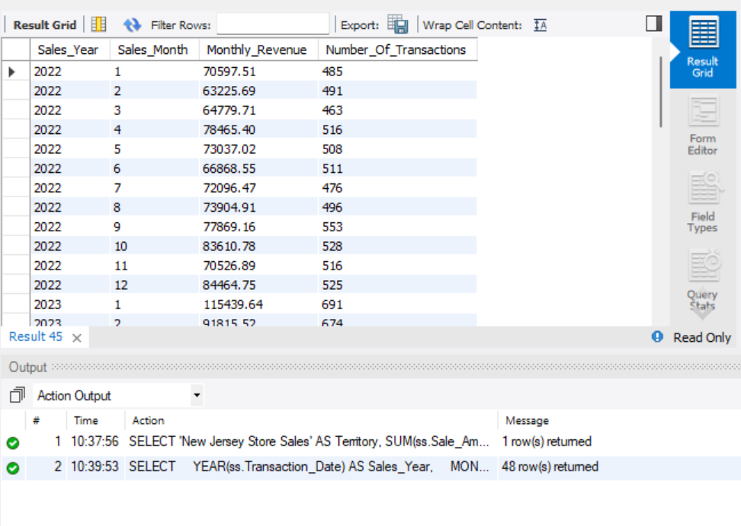
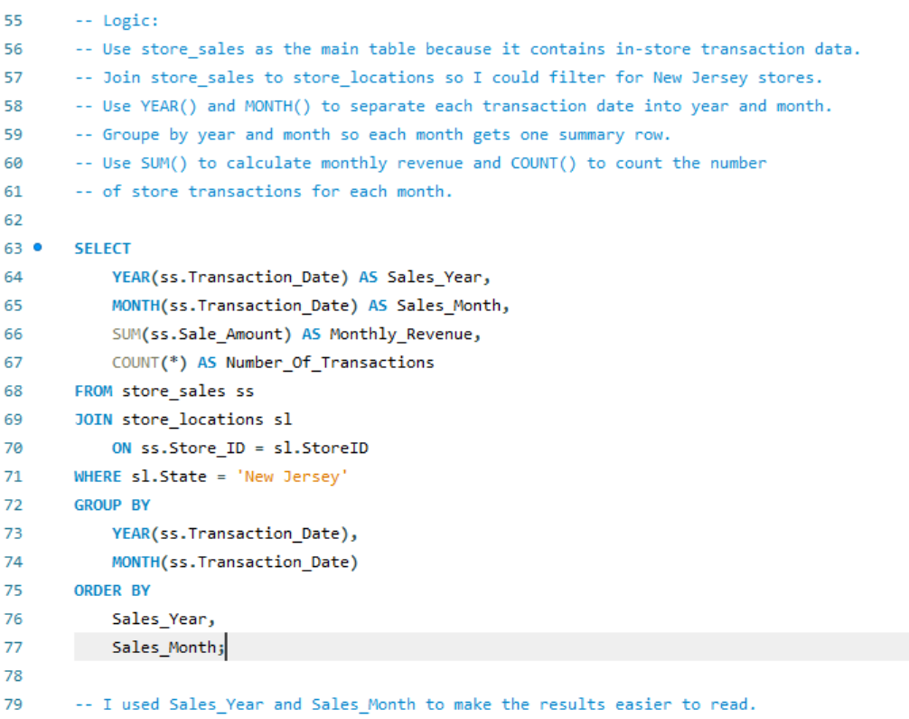
What is the month by month revenue breakdown for the sales territory?
Result
Query

Slide 6
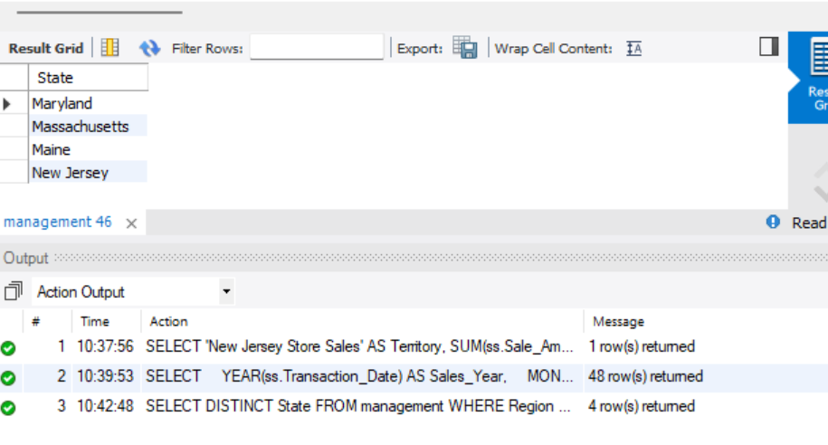
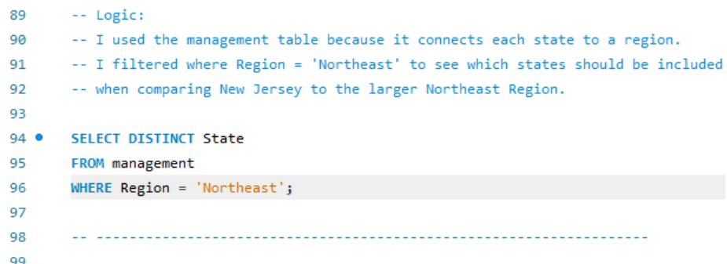
Provide a comparison of total revenue for the specific sales territory and the region it belongs to.
Result
Query

Slide 7
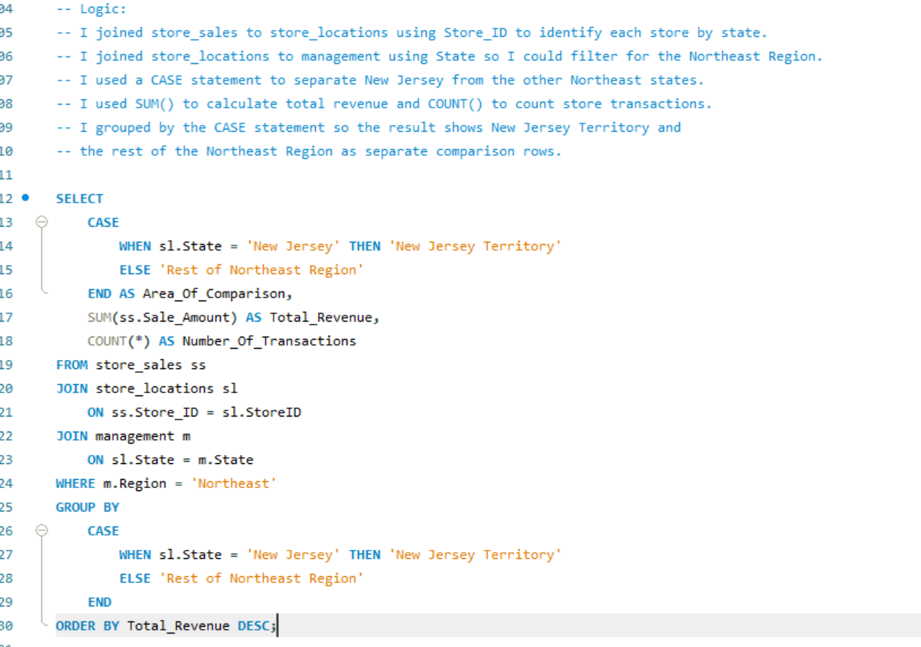
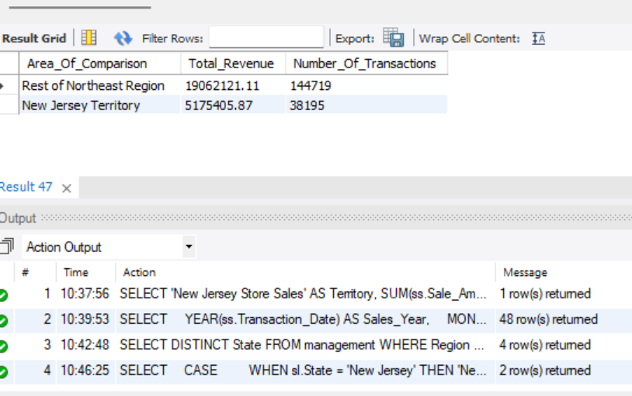
Provide a comparison of total revenue for the specific sales territory and the region it belongs to.
Result
Query

Slide 8
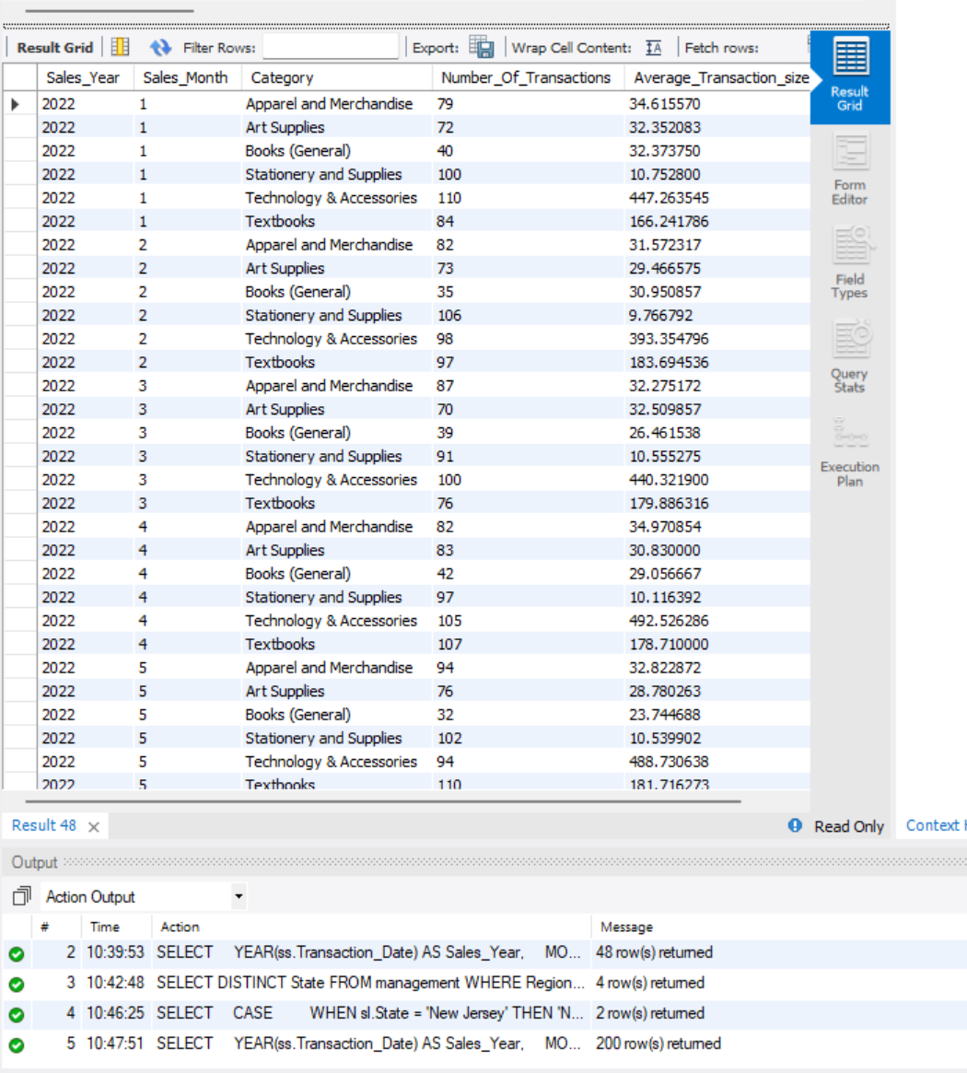
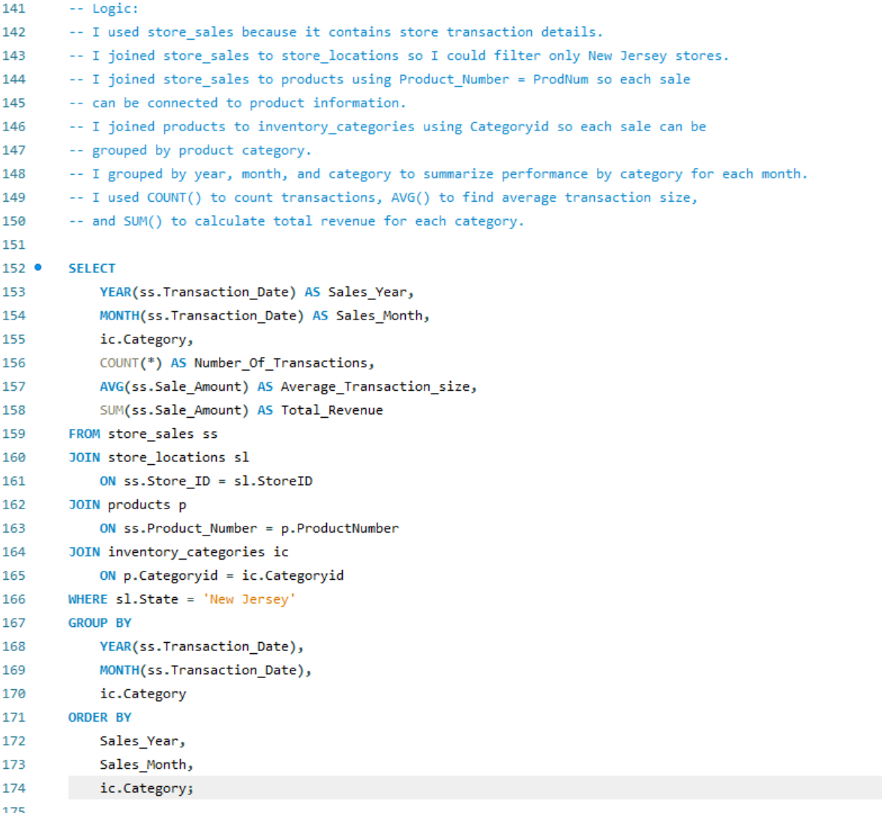
What is the number of transactions per month and average transaction size by product category for the sales territory?
Result
Query

Slide 9
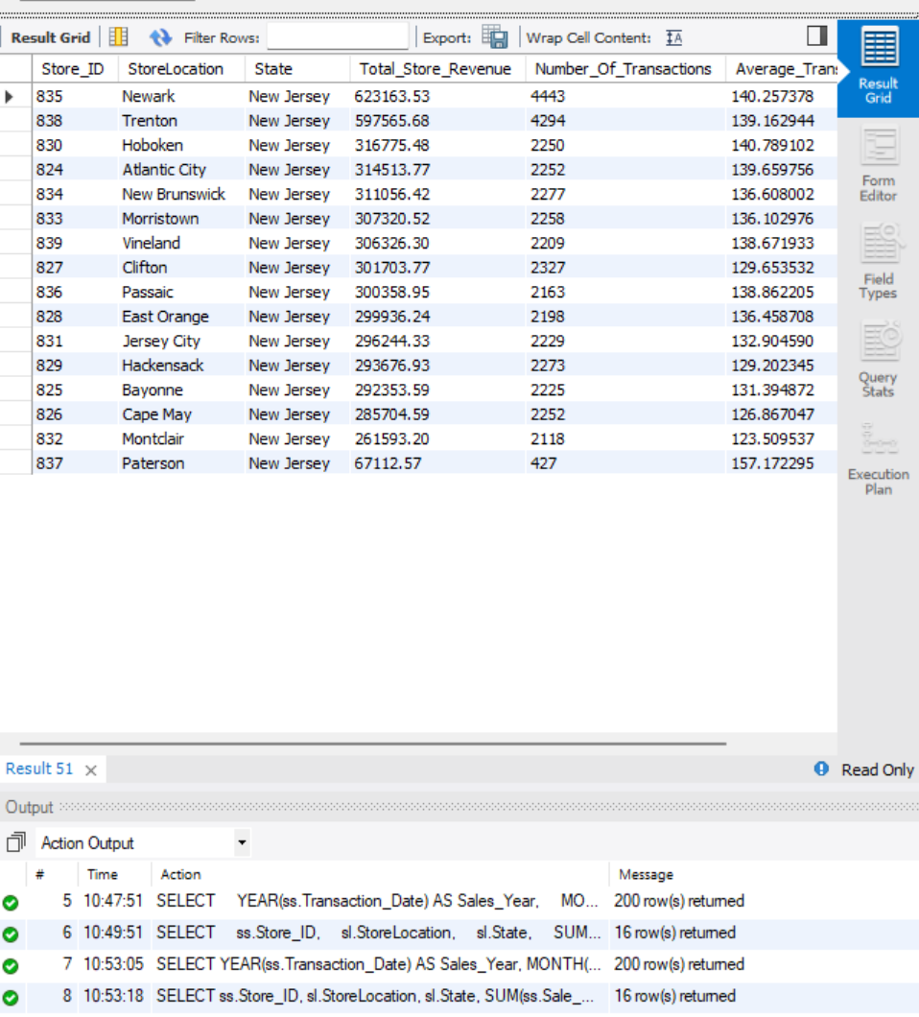
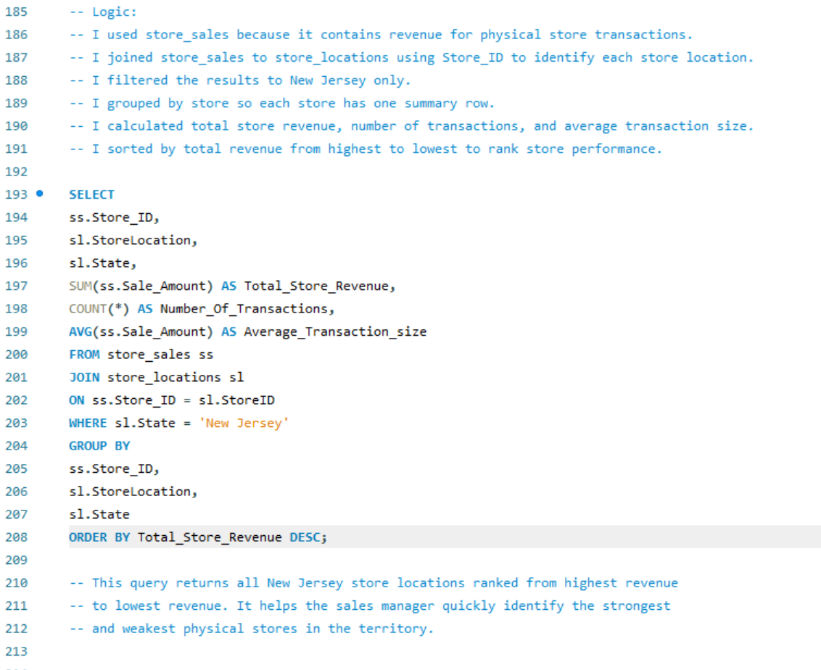
Can you provide a ranking of in-store sales performance by each store in the sales territory, or a ranking of online sales performance by state within an online sales territory?
Result
Query

Slide 10
What is your recommendation for where to focus sales attention in the next quarter?
Based on my New Jersey store sales analysis, My recommendation for next quarter is to focus on low-performing stores and weak product categories.
From the store results, Newark and Trenton are the top-performing stores, so they should be used as a benchmark.
The lowest-performing store is Paterson, which has low total revenue and fewer transactions, meaning it likely needs more customer traffic, promotions, or better store
strategy.
Other lower-performing stores like Montclair, Cape May, and Bayonne also need attention because they are below average compared to the top stores.
For product categories, Technology & Accessories and Textbooks are the strongest because they generate the most revenue and higher transaction values. On the other
hand, Stationery and Supplies and Books generate a lower revenue and low average transaction size.
To improve performance, stores can bundle low-value items with higher-value products to increase the average transaction size.
Next quarter focus:
1. Improve low-performing stores like Paterson
2. Increase customer traffic and sales activity
3. Strengthen weak categories
4. Apply strategies from top stores like Newark and Trenton
5. Increase total revenue and average transaction size
Overall, the goal is to close the gap between low and high-performing stores and improve overall store sales in New Jersey.

Slide 11
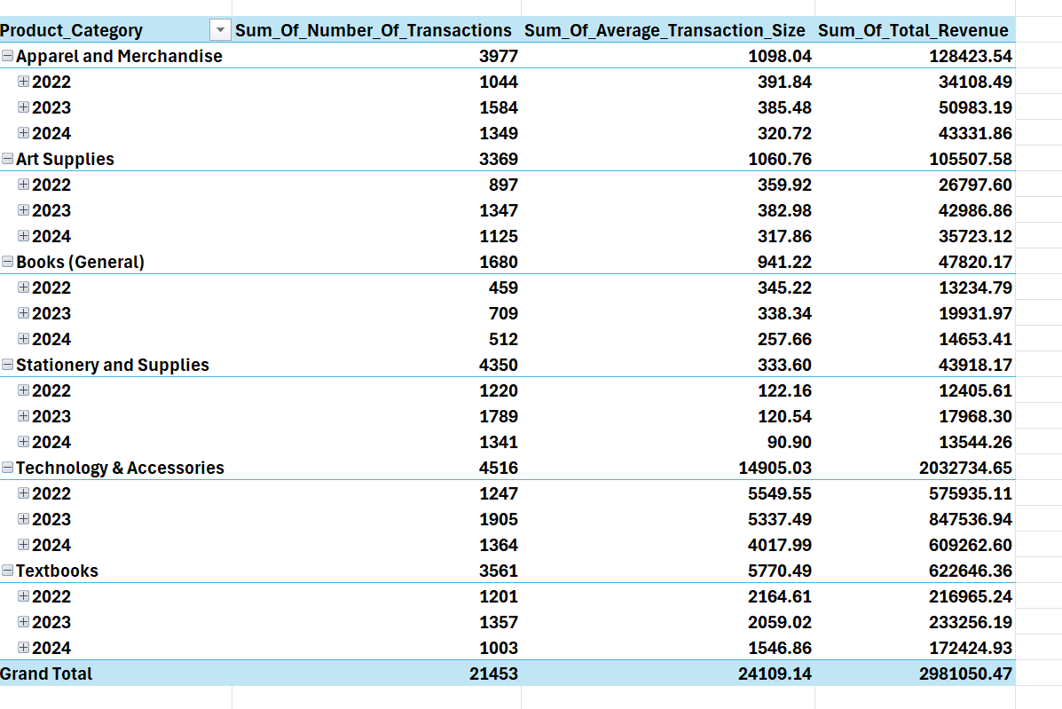
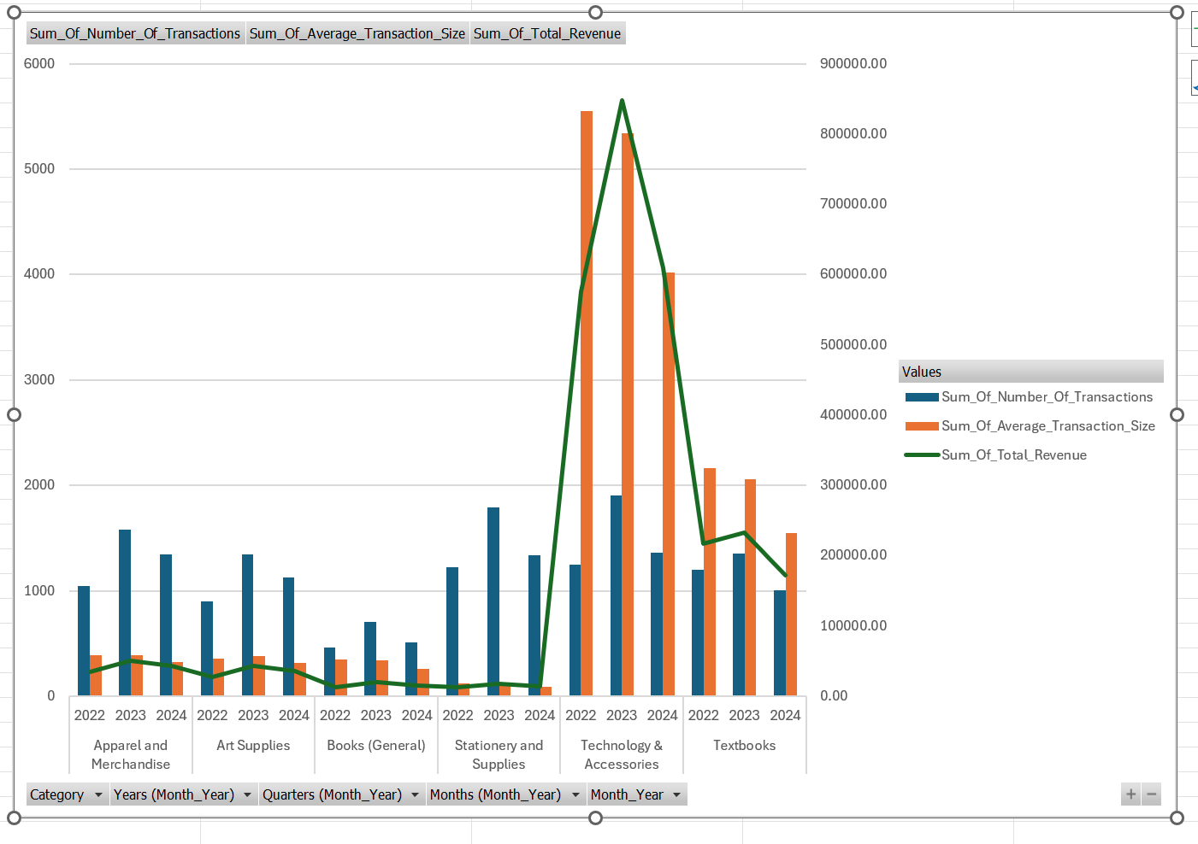
Visualization
What is the number of transactions per month and average transaction size by product category for the sales territory?
Pivot Table
PivotChart

Slide 12
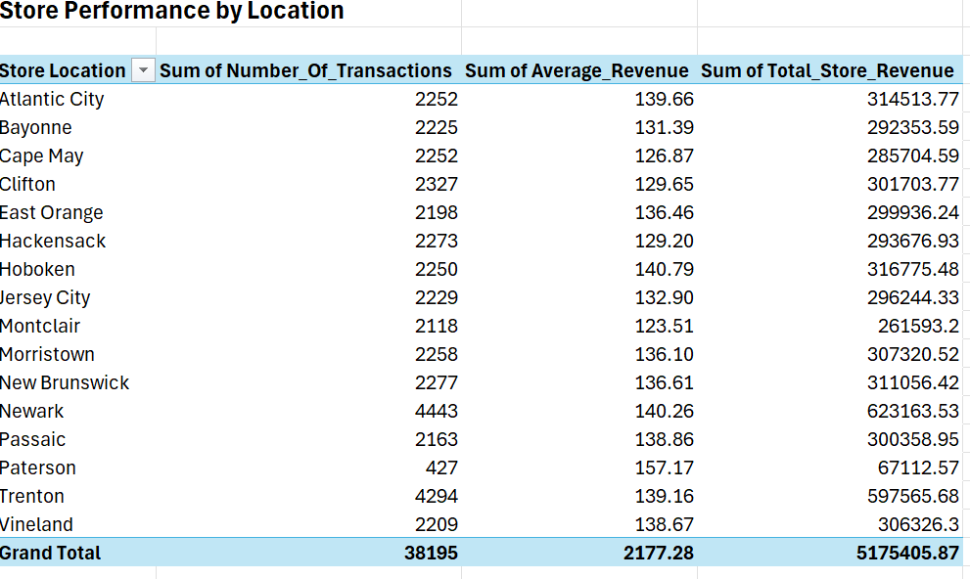
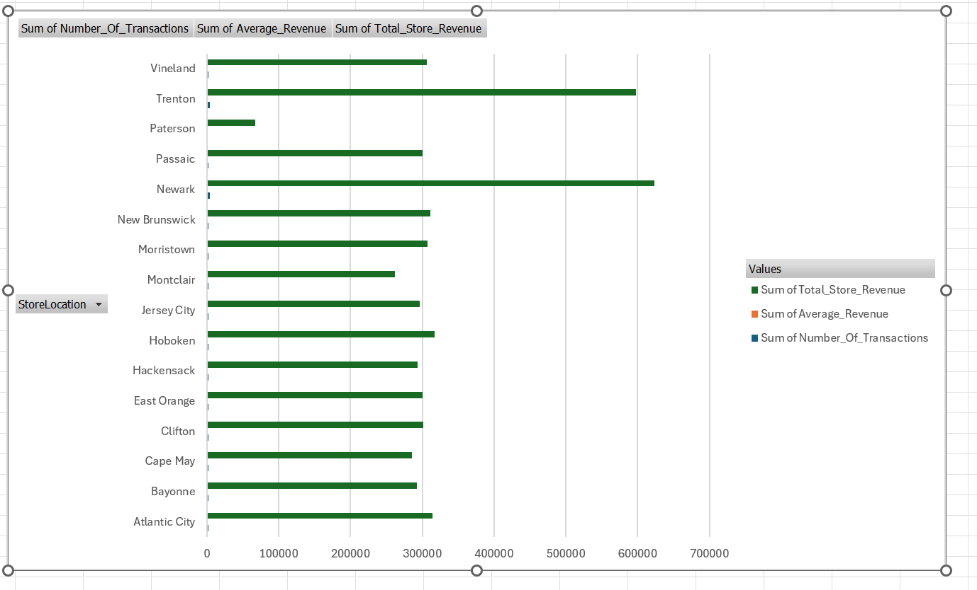
Visualization
Can you provide a ranking of in-store sales performance by each store in the sales territory, or a ranking of online sales performance by state within an online sales territory?
Pivot Table
PivotChart

Slide 13
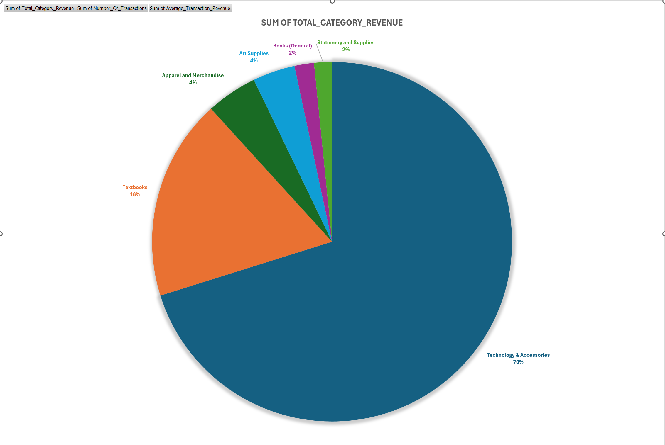
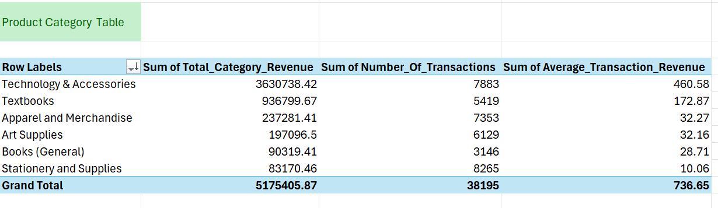
Visualization
Compare the performance of Product Categories in the New Jersey Location
Pivot Table
PivotChart

Slide 14
GitHub Repository

